Slide 1
Digital portfolio
STUDENT NAME: DHANALAKSHMI V REGISTER NO:30324U09011 Nm I’d:F0C8502483320DDBF344CCDA9312BD4A DEPARTMENT: Bachelor of Computer Applications (BCA – 2nd Year) COLLEGE: Arcot Sri Mahaalakshmi Women College (Autonomous), Vilapakkam, Ranipet University: Thiruvalluvar University

Slide 2
Project title
Interactive Digital Portfolio using Frontend Development

Slide 3
Agenda
1.Problem Statement
2. Project Overview
3. End Users
4. Tools & Technologies
5. Portfolio Design & Layout
6. Features & Functionality
7. Results & Screenshots
8. Benefits
9. Conclusion

Slide 4
Problem Statement
Traditional resumes fail to capture practical skills, creativity, and personality. Students like me need a digital portfolio that highlights academic details, technical knowledge, hobbies, and projects in an interactive and professional way.

Slide 5
Project Overview
This project focuses on building a personal portfolio website using HTML, CSS, and JavaScript.
It includes sections like:
Home About Me 👩‍🎓 Skills 💻 Hobbies 🎨 Certification Contact 📧
The portfolio is responsive, user-friendly, and a reflection of both technical and creative strengths.

Slide 6
End users
Students – to present their skills and achievements Job Seekers – for internships & placements Recruiters/Employers – quick overview of candidates Teachers & Evaluators – academic assessments

Slide 7
Tools & technology
Frontend Languages: HTML, CSS, JavaScript Editor: Visual Studio Code Version Control & Hosting: Git & GitHub Design Techniques: Responsive Design, Flexbox, Grid, Animations

Slide 8
Portfolio design and layout
1.Home Page: Intro with name & course 2. About Me: Personal details, Education details, goals, achievements 3. Skills: Computer knowledge, teamwork, creativity 4. Hobbies: Dancing, Listing music 5. Contact: Email, links Style: Clean, formal, discipline-focused design with interactive feat

Slide 9
Features and functionality
✅ Responsive (works on mobile & desktop) ✅ Smooth navigation with menus ✅ Interactive cards & animations ✅ Contact links (Email / Socials)

Slide 10
Result
✅ Successfully developed a Digital Portfolio Website. ✅ Portfolio includes Home, About , Skills, Hobbies, certificates, and Contact sections. ✅ Design is responsive – works smoothly on both desktop and mobile. ✅ Interactive features like smooth scrolling, hover animations, and buttons. ✅ Clean, formal layout with gradient background and card-style sections.

Slide 11
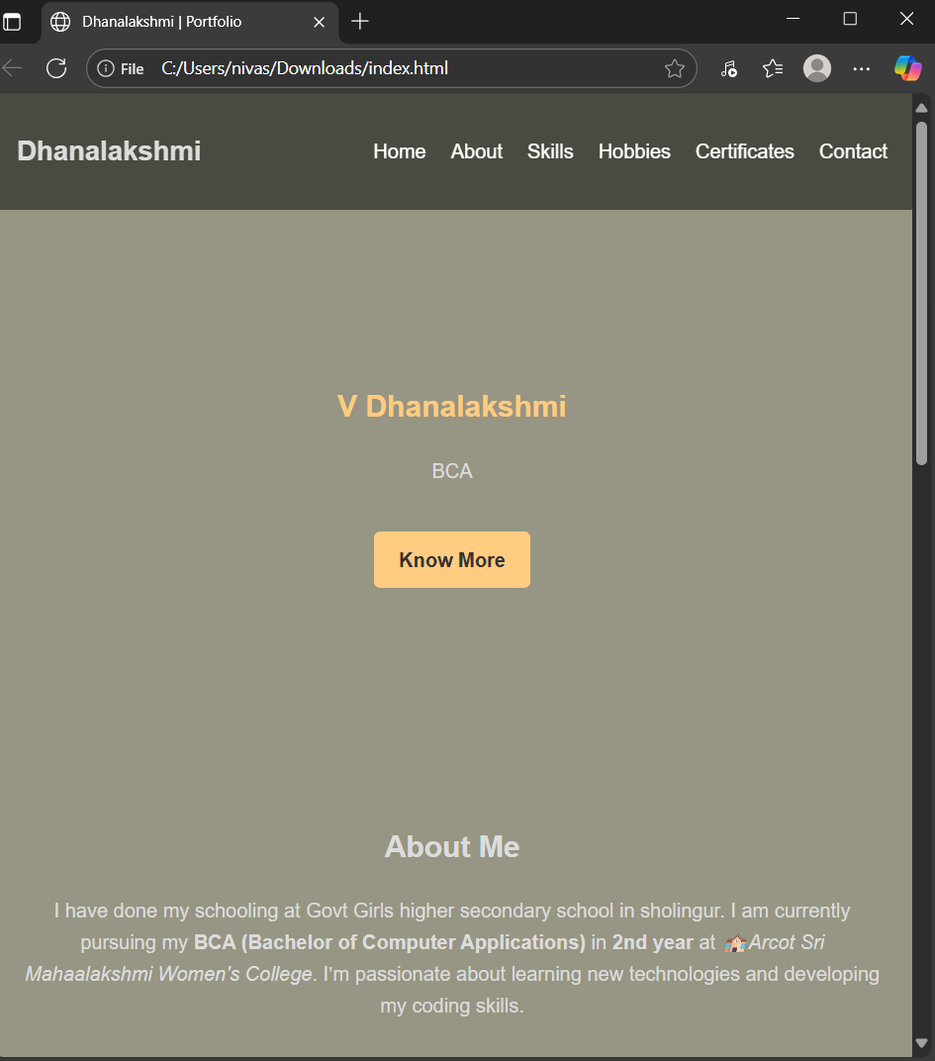
Screenshots 1
Home Page (Hero Section) Displays the student’s name Dhanalakshmi V and course (Studying 2nd BCA) details etc. Contains a stylish “Know More” button that smoothly scrolls to the next section.

Slide 12
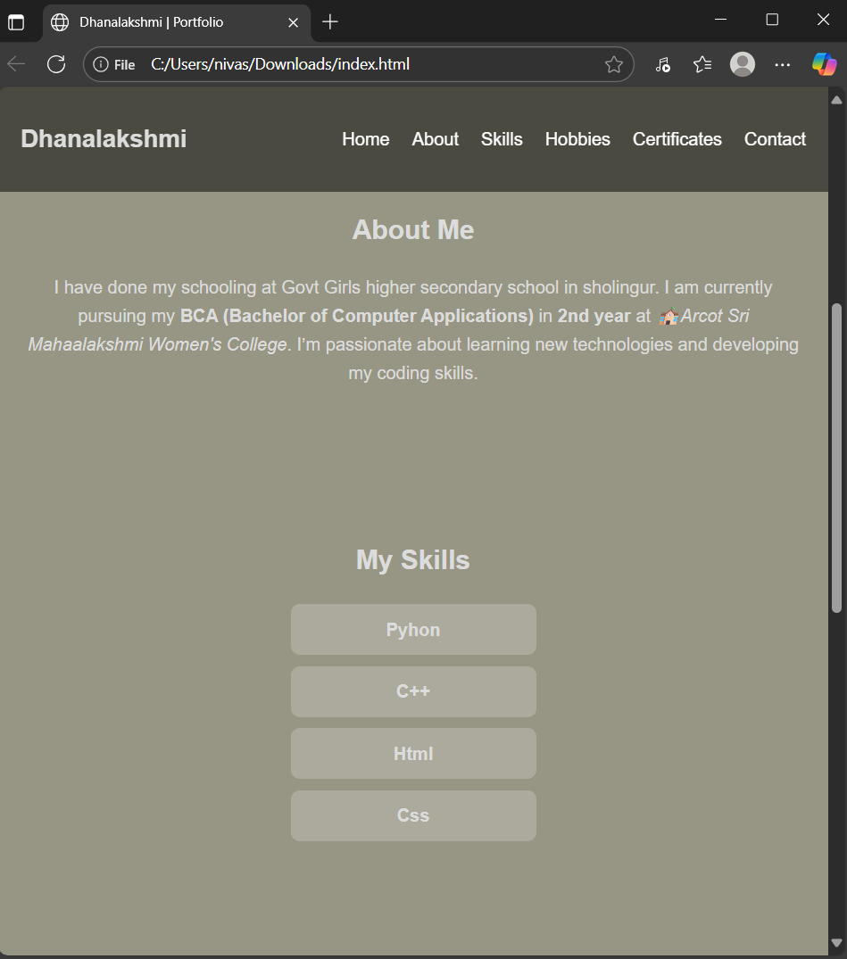
Screenshots 2
About Me & My skills The About Me card introduces Dhanalakshmi details, Emphasizes the current academic program – BCA (2nd Year) at Arcot Sri Mahalakshmi Women College (Autonomous), Ranipet. Explains skills: to improve computing knowledge and excel in creative fields. Education section is presented with icons and bold emphasis for easy readability.

Slide 13
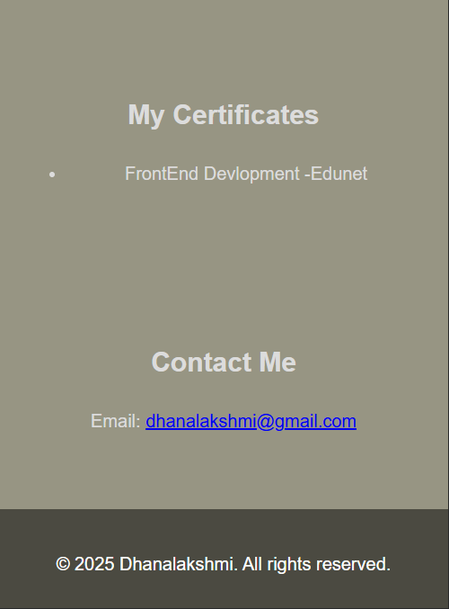
Screenshots 3
Certification & Contact Section Certification section will display the Front End Development certification issued by Edunet. Contact Section: Features a clickable email link (dhanalakshmi@gmail.com), making it easy for recruiters or faculty to connect.

Slide 14
Benifits
Showcases skills & creativity Acts as a digital resume Easy to update anytime Helps in placements & interviews Encourages personal branding

Slide 15
Conclusion
My portfolio project demonstrates how students can present skills, hobbies, and achievements in a structured, professional, and engaging way. It is not only a digital resume but also a reflection of personal growth and creativity, making it useful for future career opportunities.

Slide 16
Thank you

